Slide 1

COMPOSITION API
&
SCRIPT SETUP

Slide 2
WHY COMPOSITION API?

Slide 3
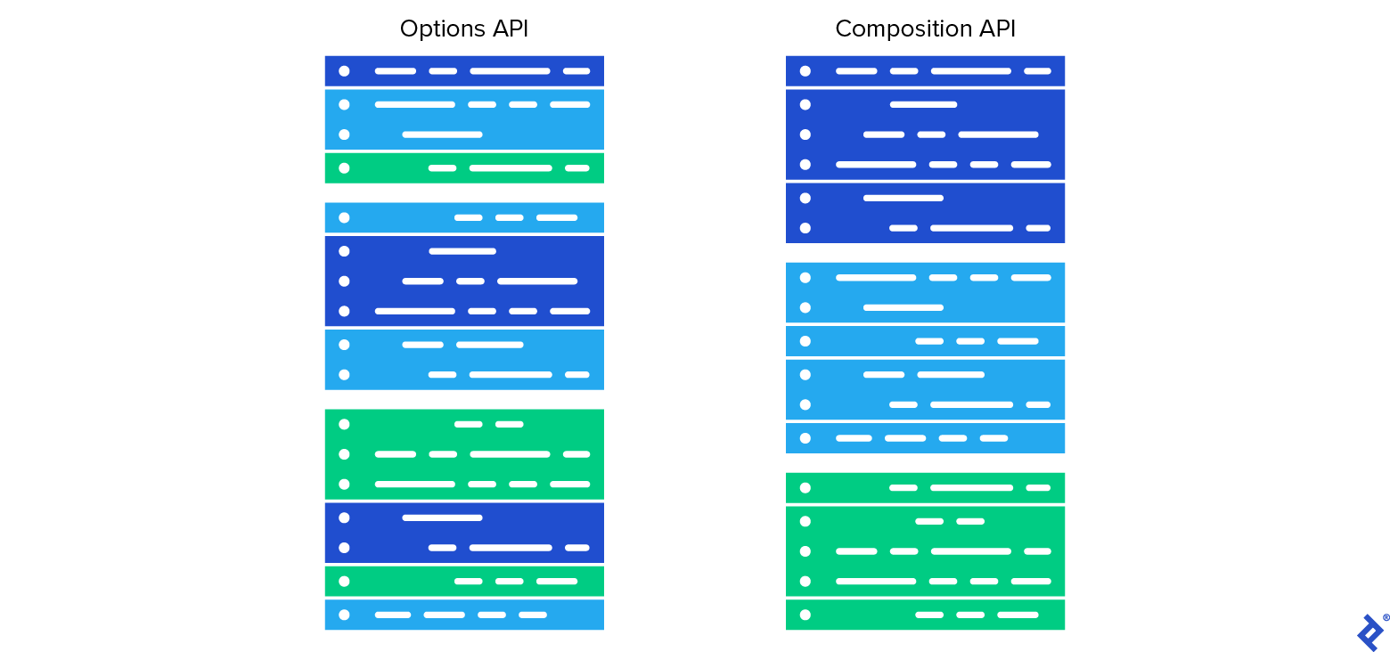
More Readable And Maintainable

Slide 4
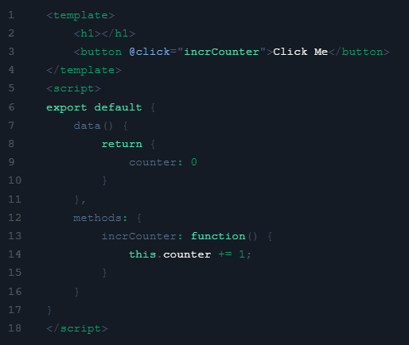
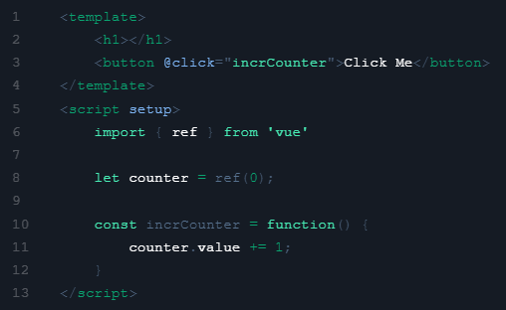
LESS CODE
Option API
Composition API

Slide 5
What is Script Setup?
< script setup > < /script >

Slide 6
What is Script Setup?
<script setup> is a compile-time syntactic sugar for using Composition API inside Single-File Components (SFCs)

Slide 7
THANKS

Slide 8
REFERENCES
https://www.youtube.com/watch?v=6HUjDKVn0e0
https://vuejs.org/guide/extras/composition-api-faq.html

